Slide 1
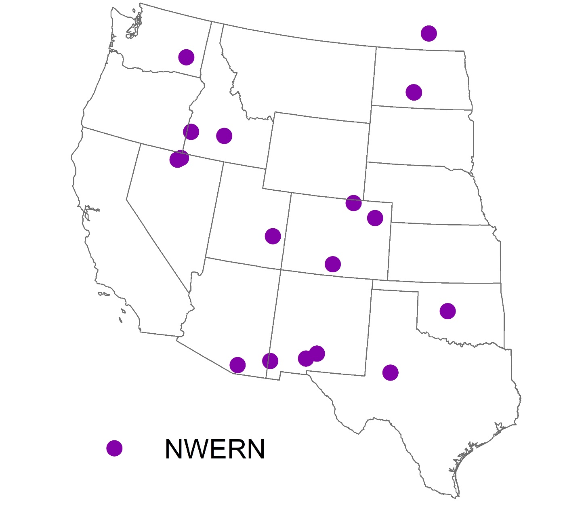
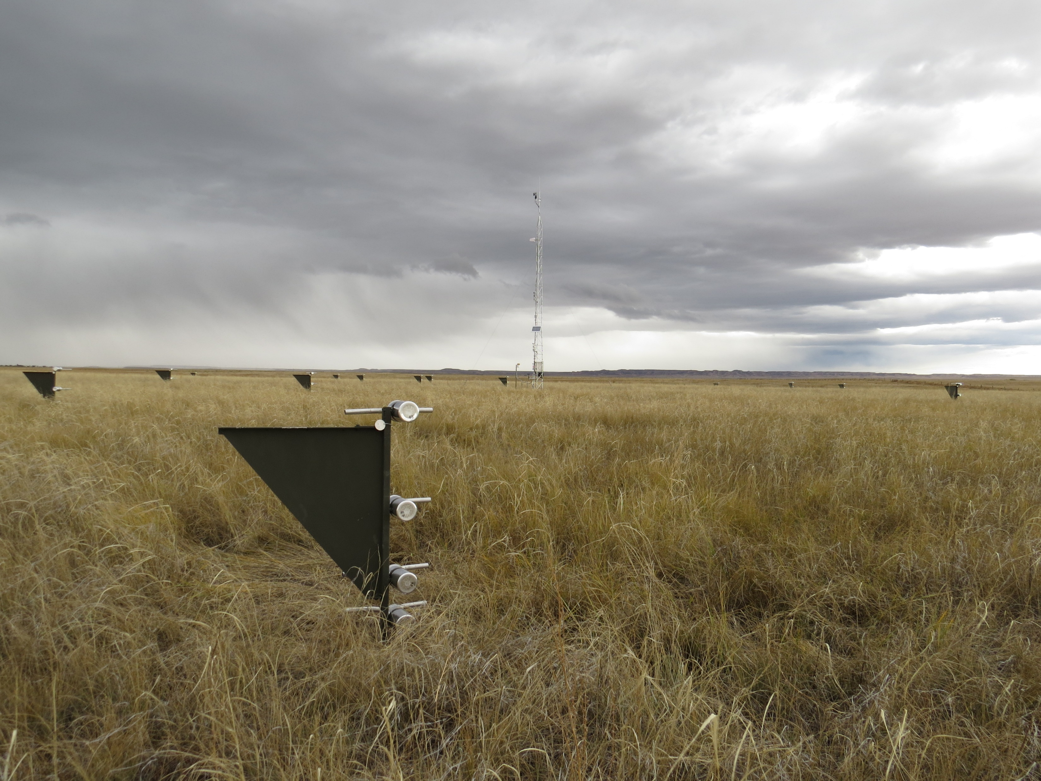
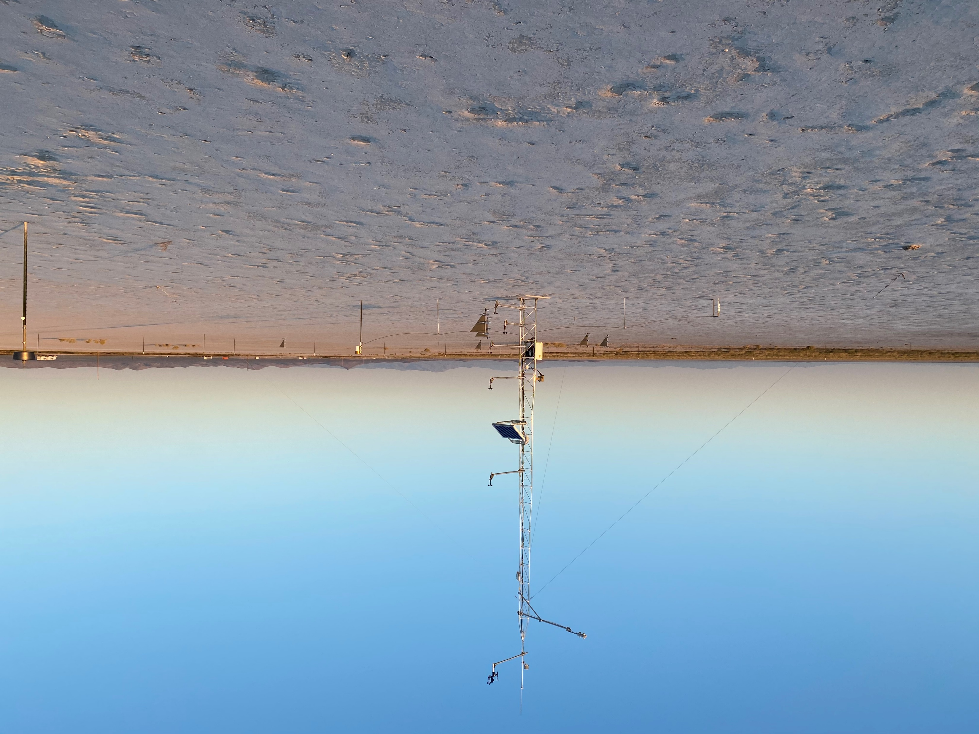
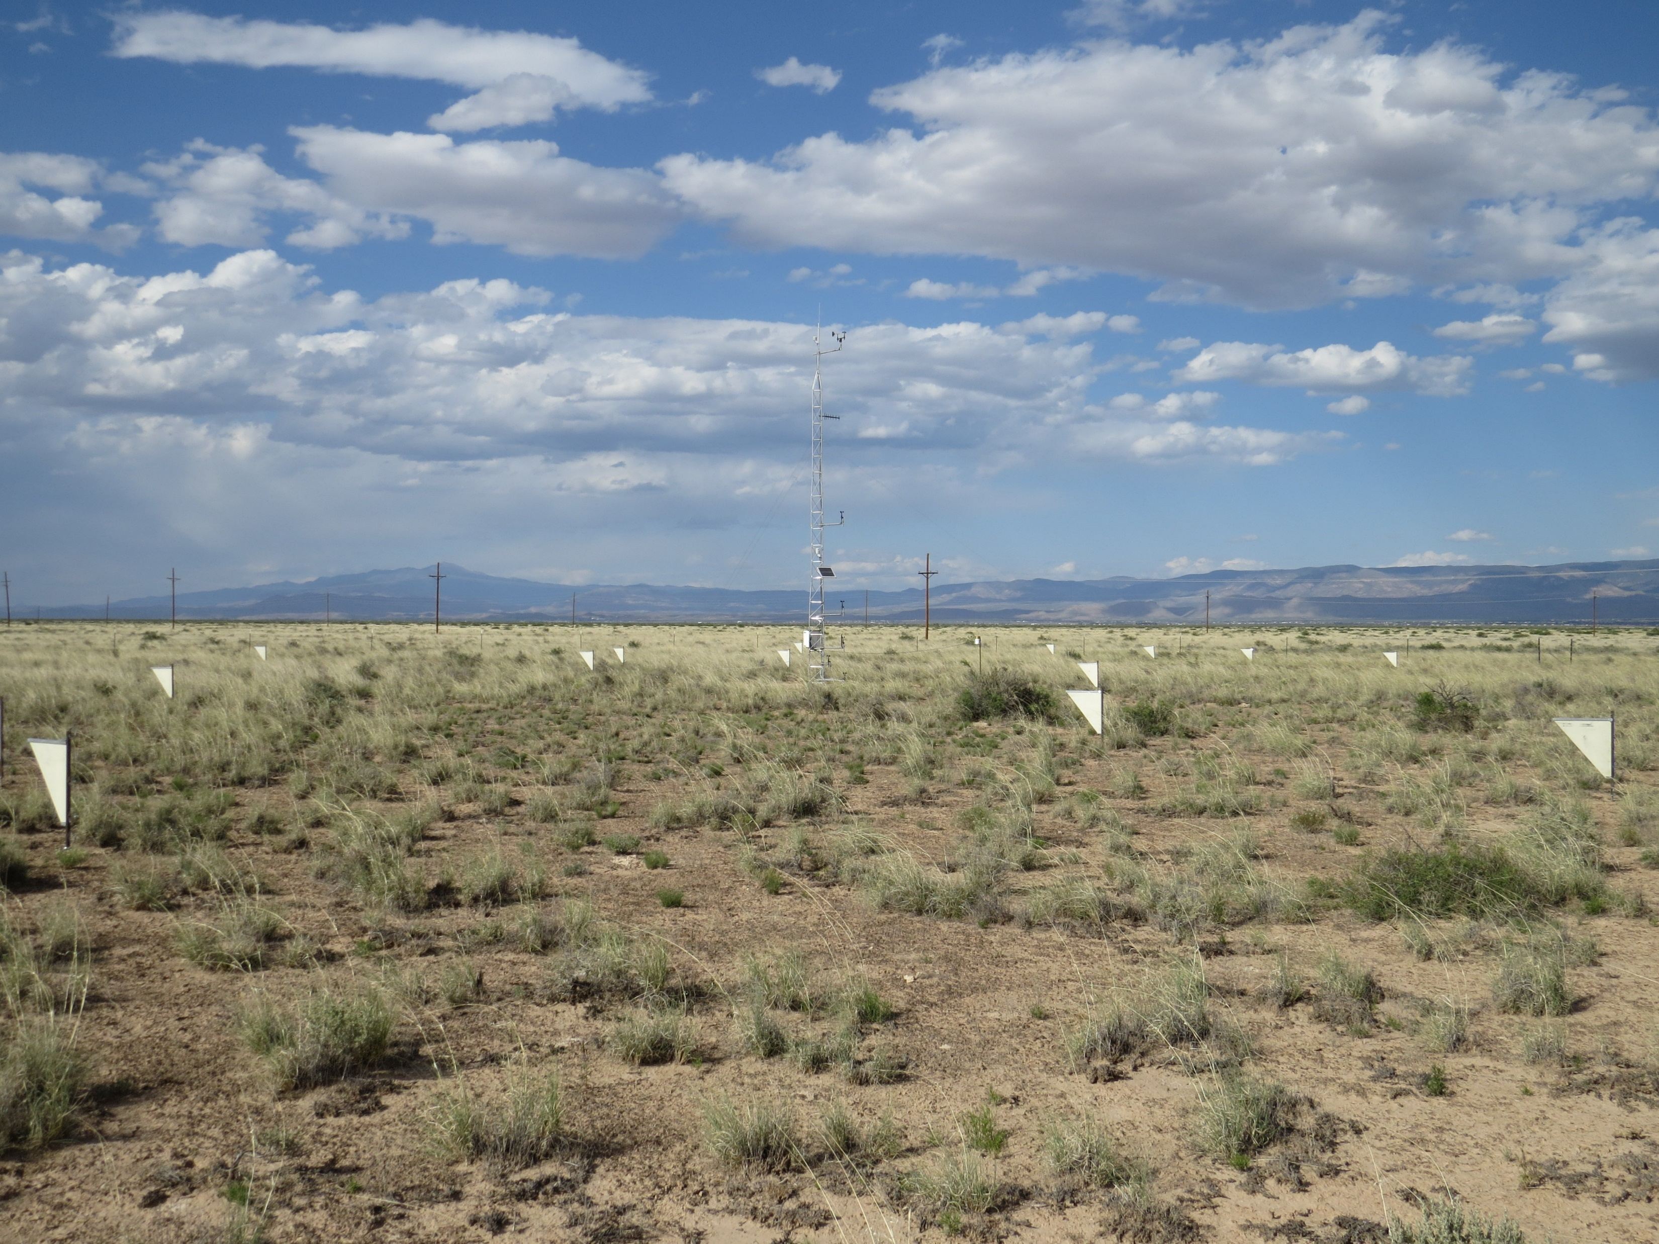
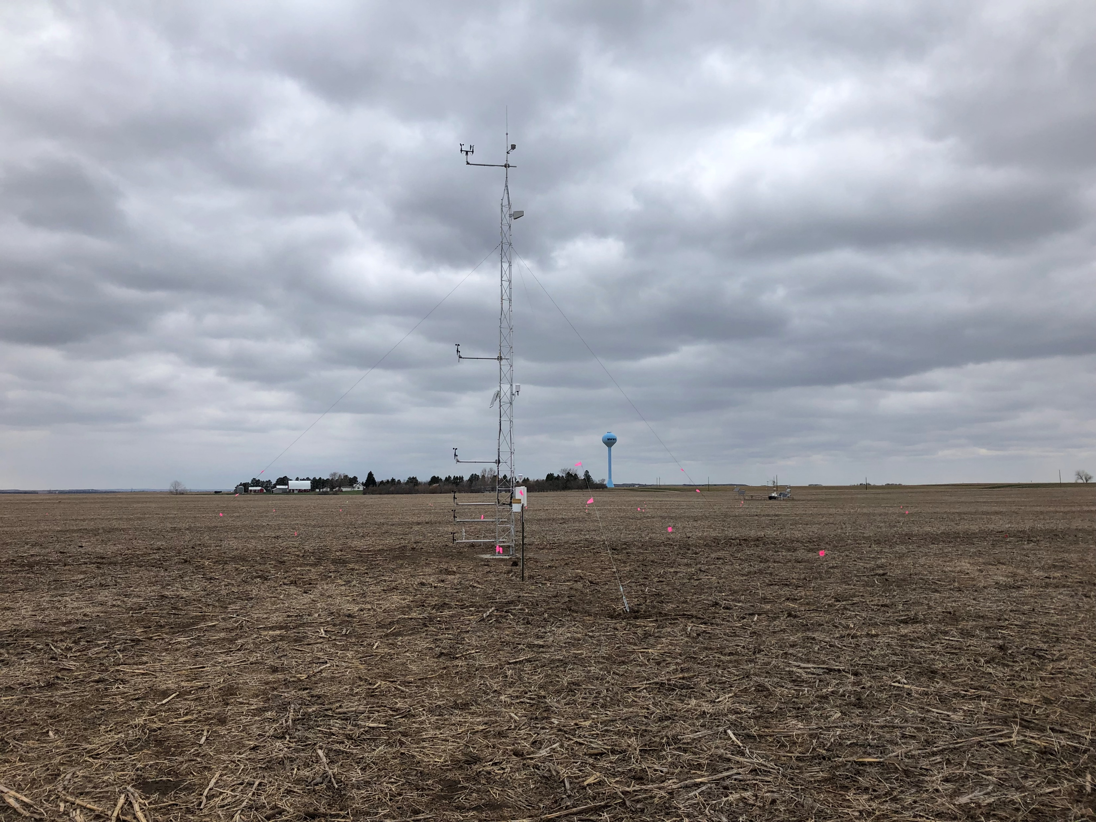
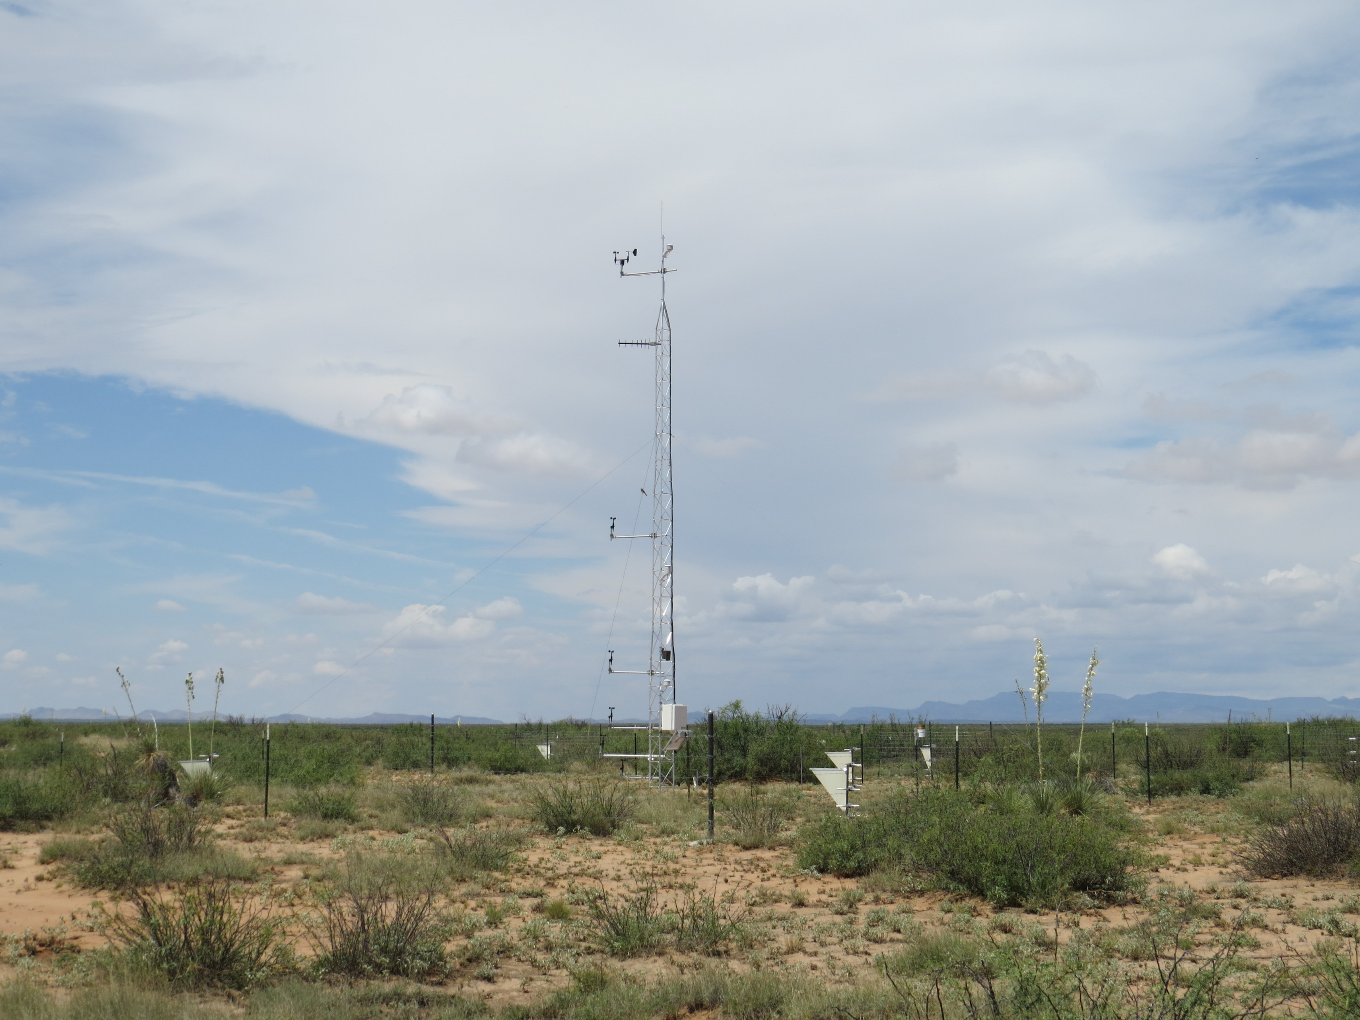
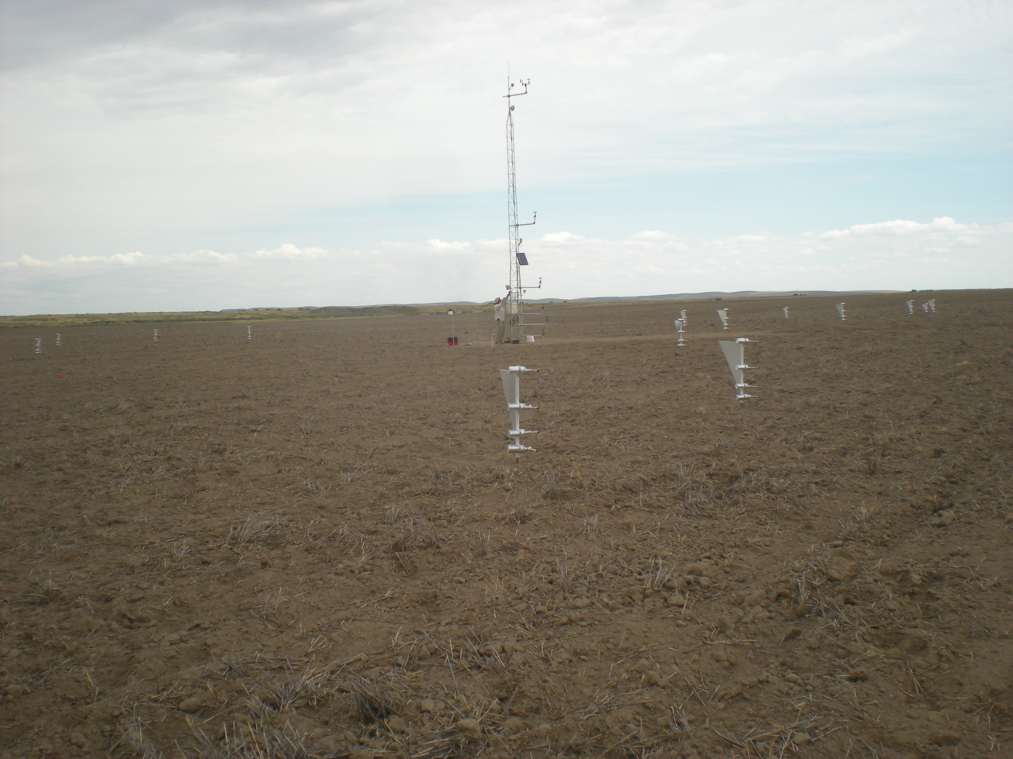
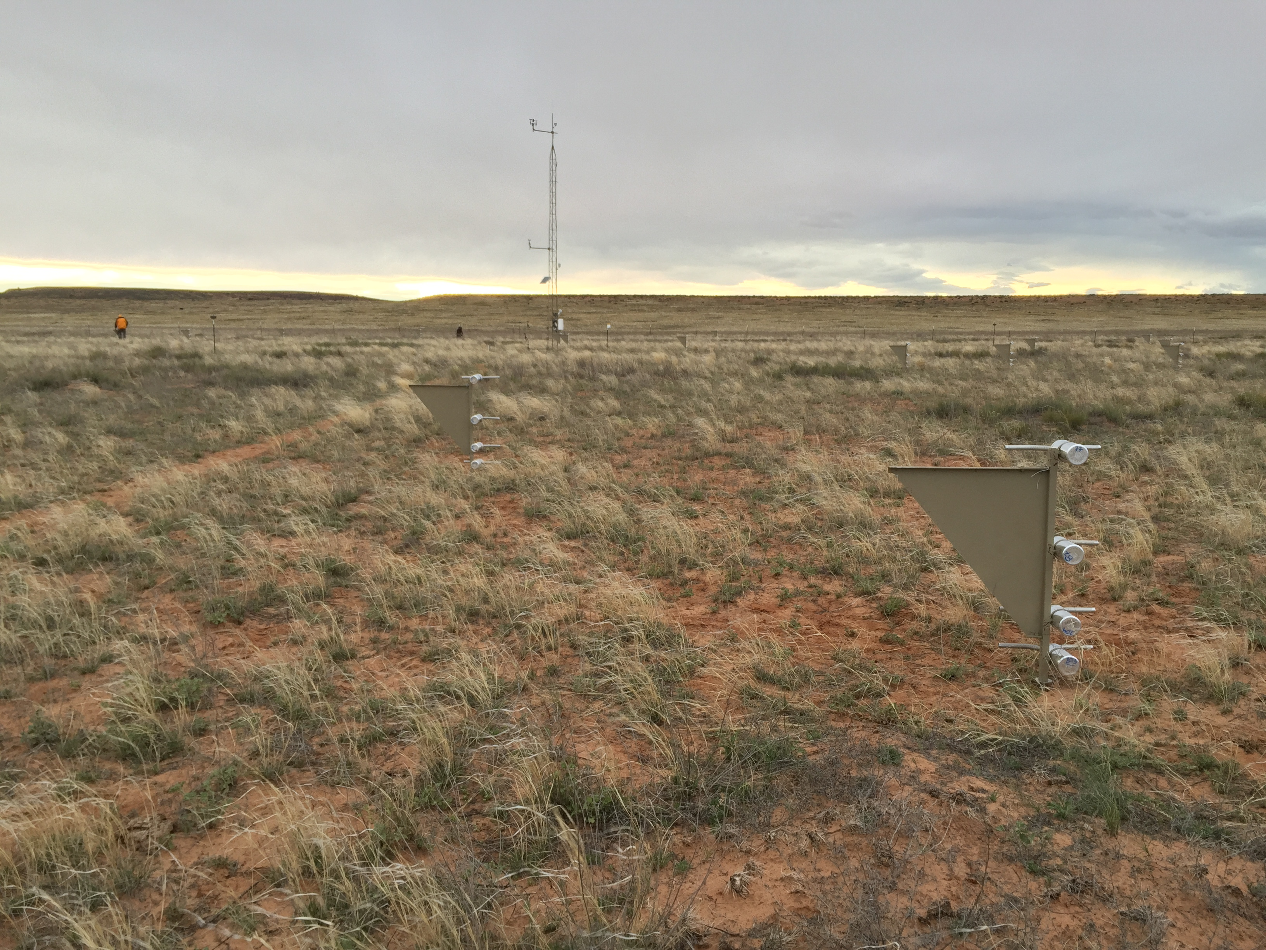
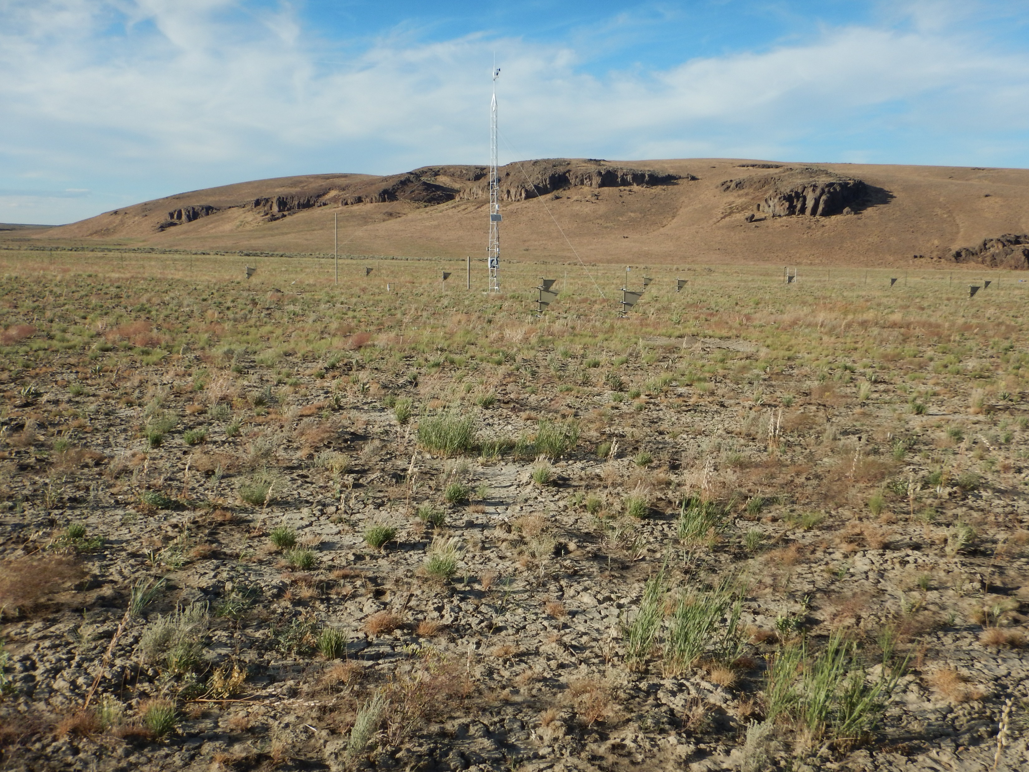
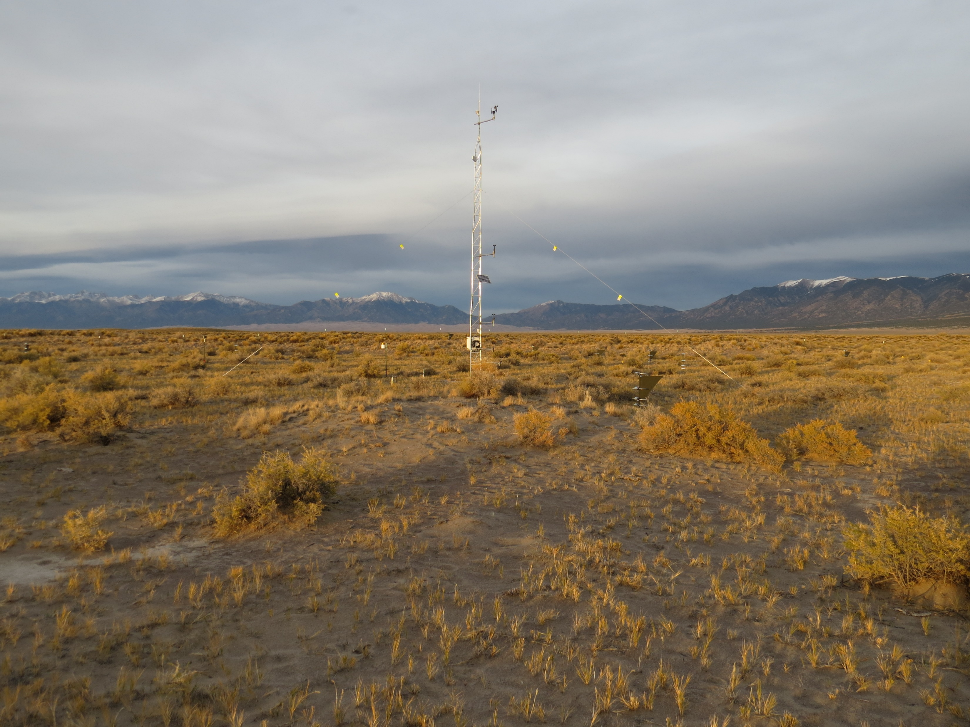
CPER
Lordsburg
Holloman
Morton
Jornada
Pullman
100 m
Moab
Red Hills
San Luis Valley

Slide 2
LPI

Slide 3
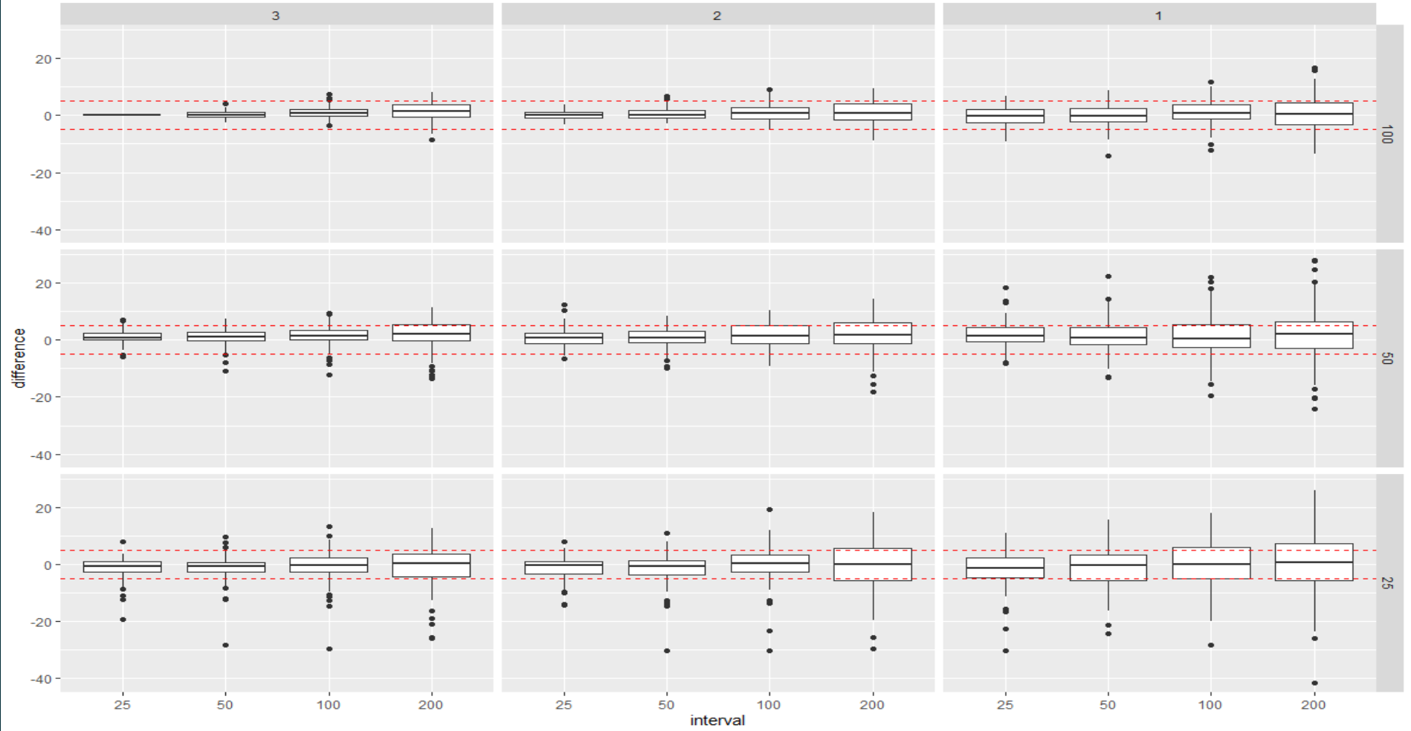
Difference from NWERN base

Slide 4
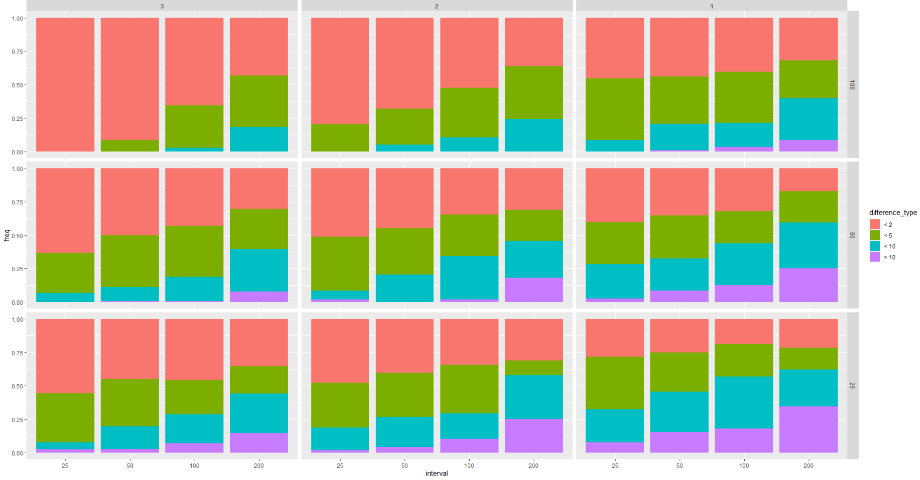
Proportion of absolute difference from NWERN Base

Slide 5
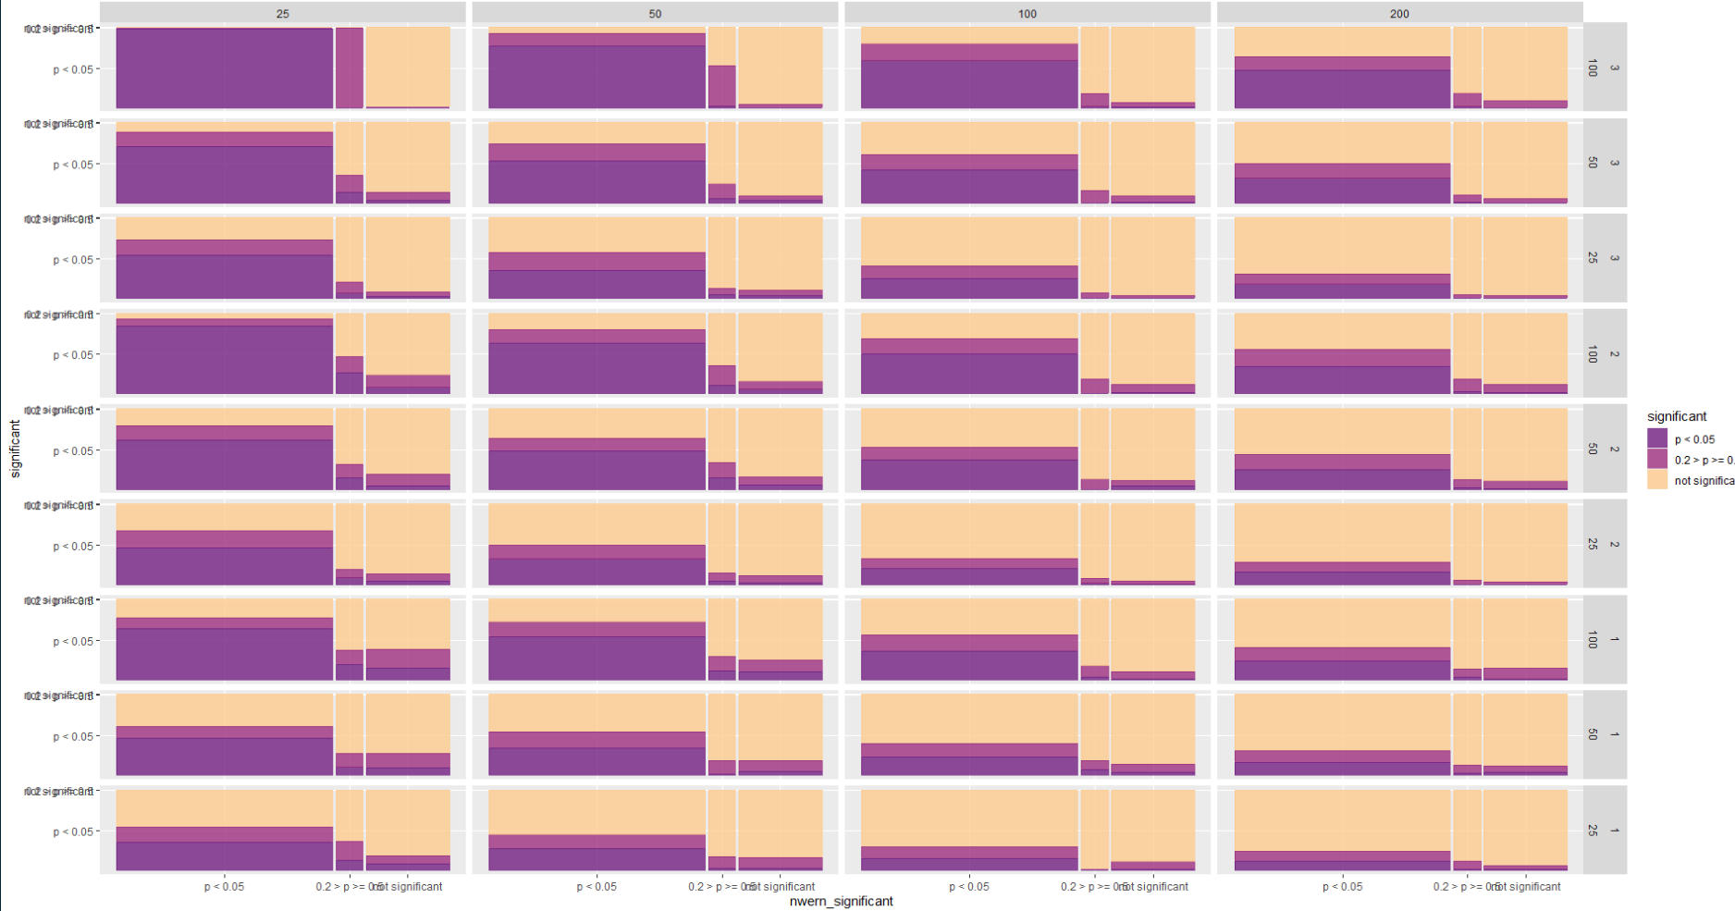
Plot visit significant differences –both p < 0.05 and p < 0.2

Slide 6
LPI—plot reorganized

Slide 7
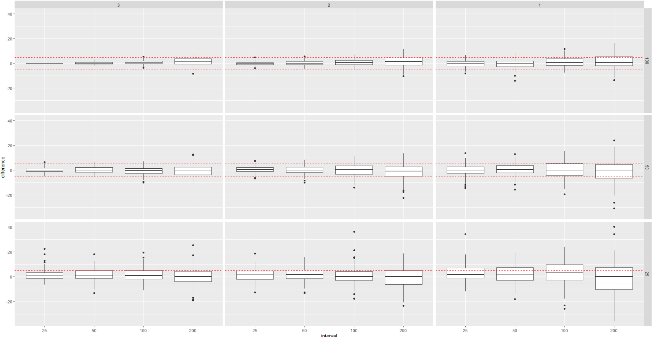
Difference from NWERN base

Slide 8
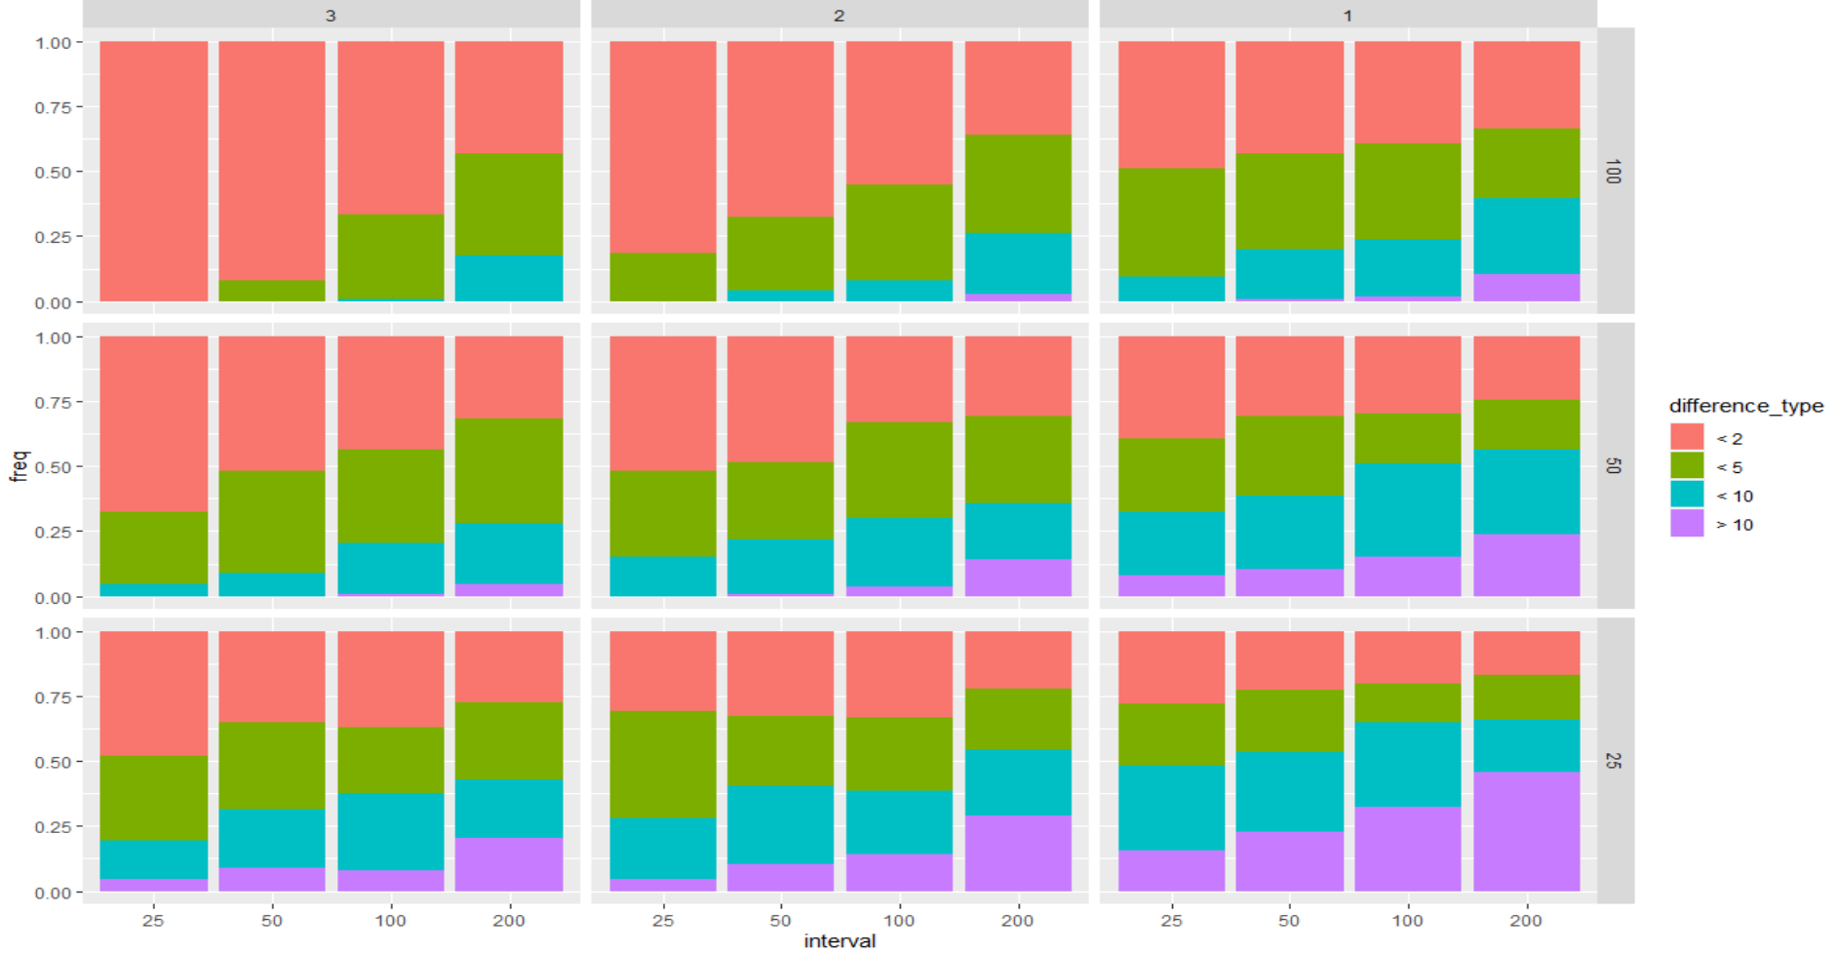
Proportion of difference from NWERN Base

Slide 9
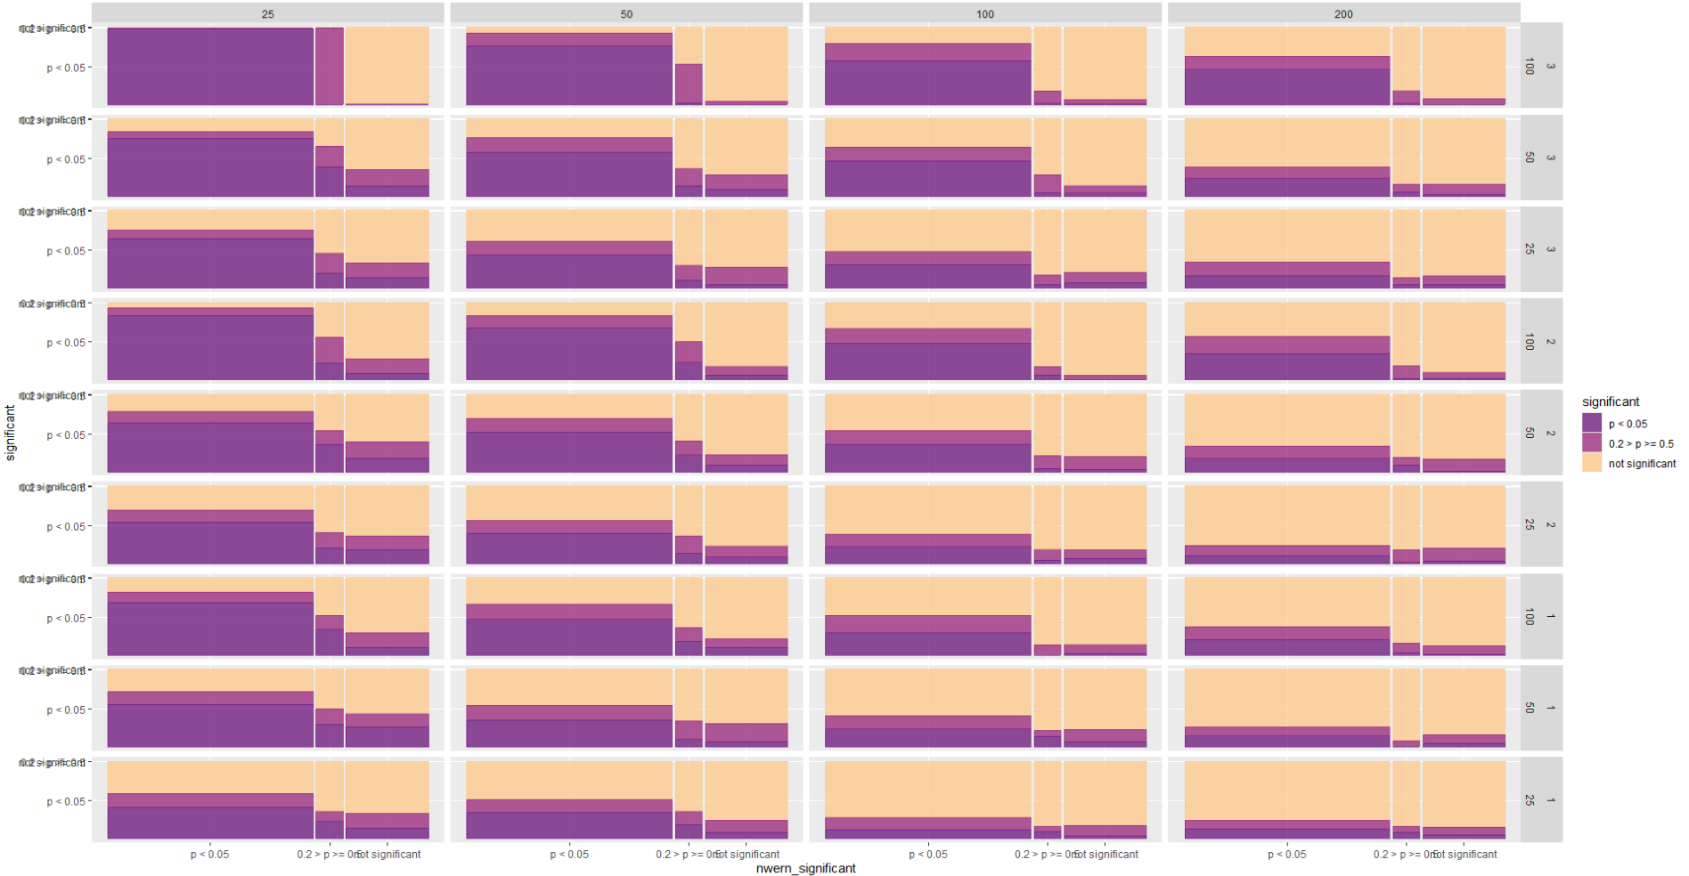
Plot visit significant differences –both p < 0.05 and p < 0.2

Slide 10
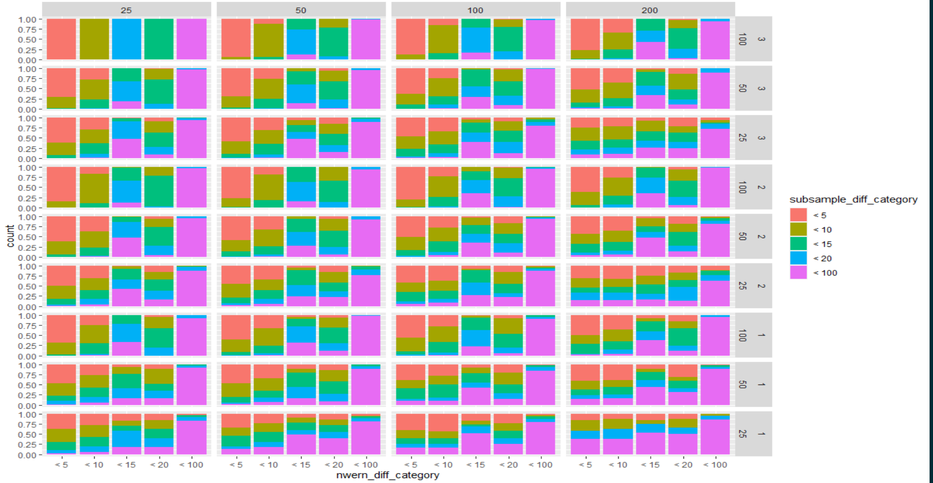
Plot visit absolute differences

Slide 11
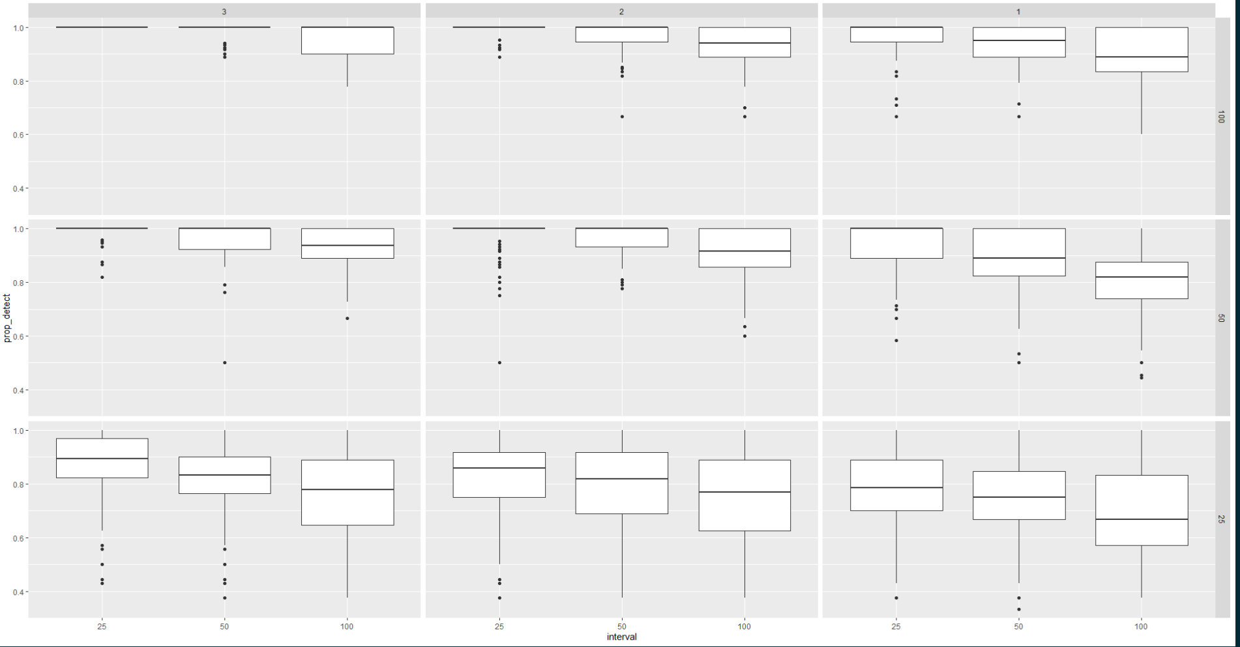
Species detection – proportion detected

Slide 12
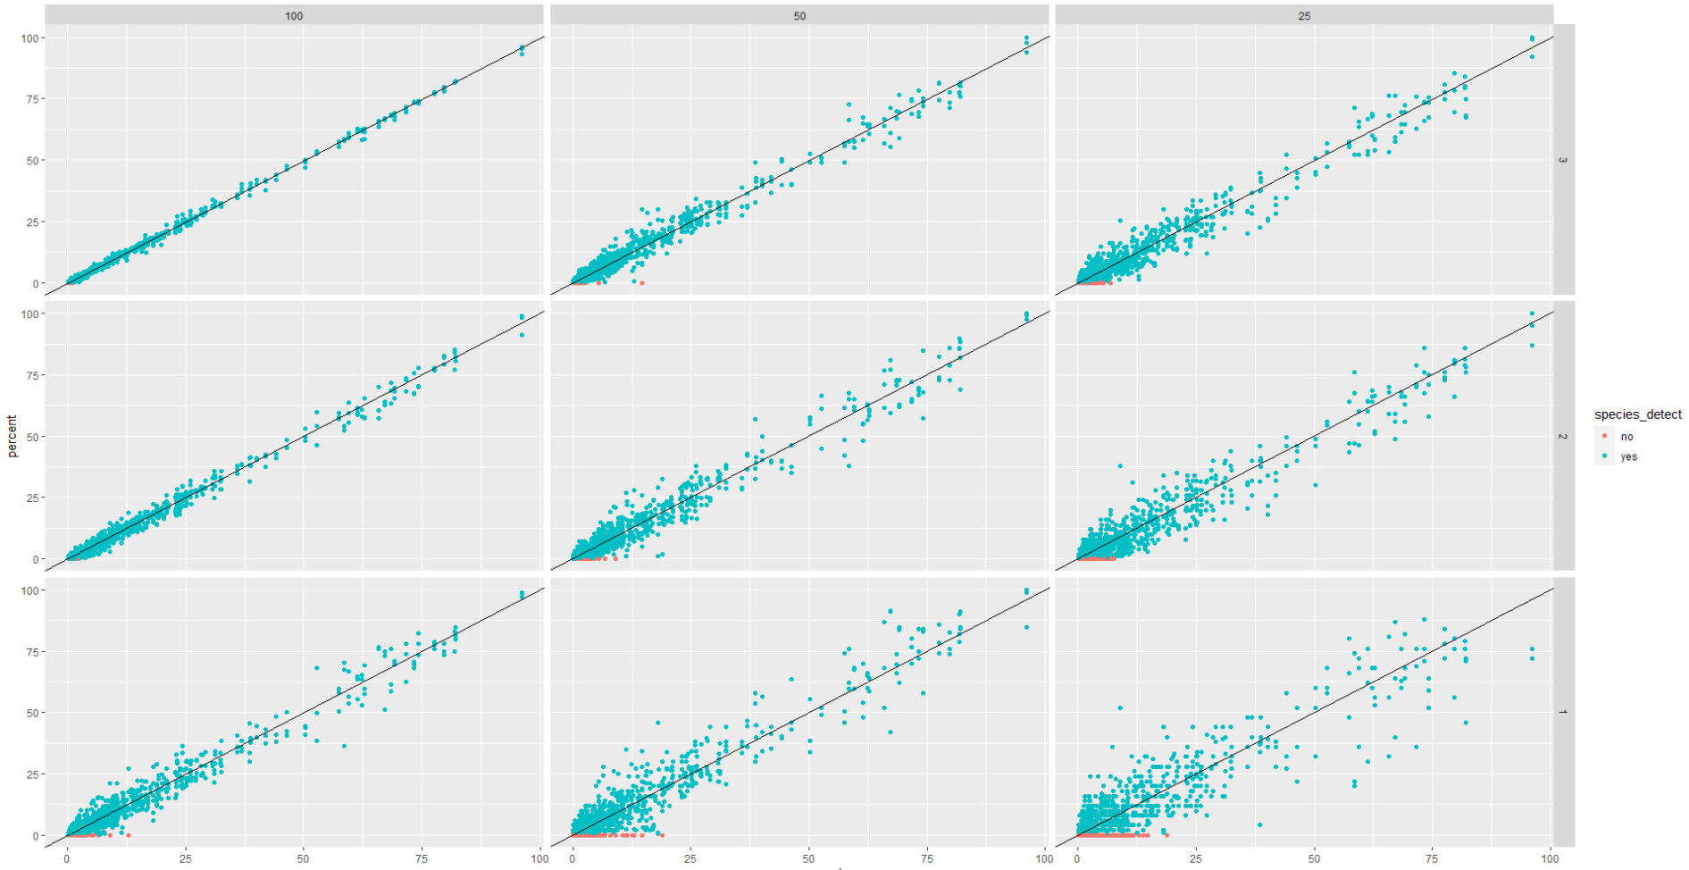
Species detection –species not detected as a function of cover (species > 20% cover always detected)

Slide 13
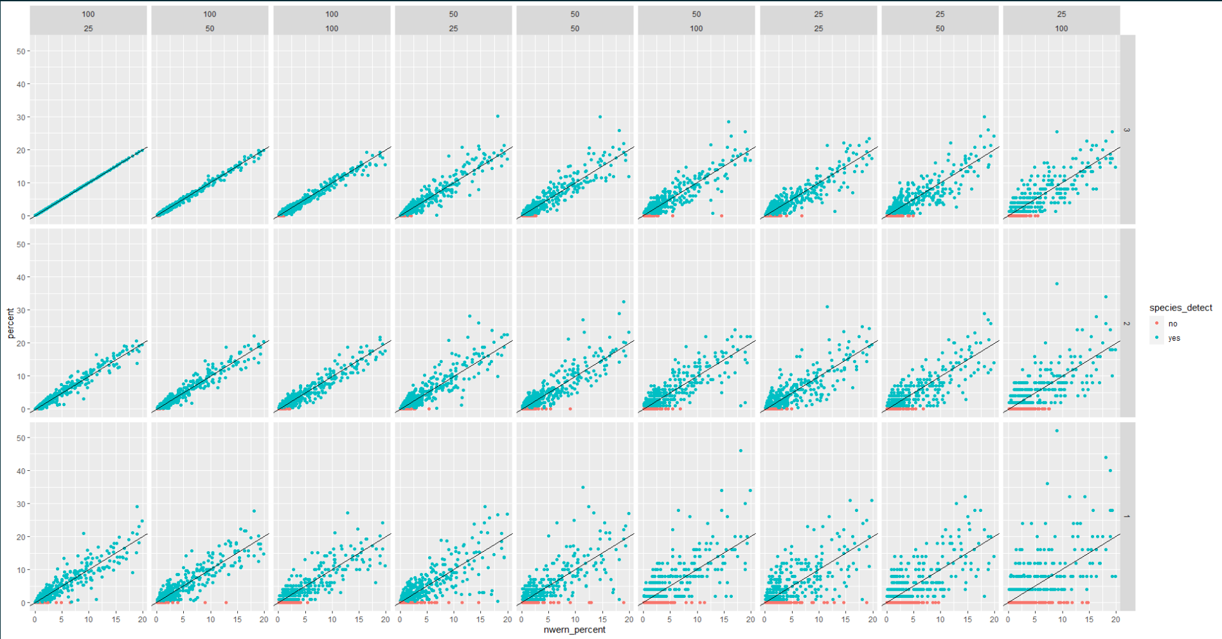
Species detection –species not detected as a function of cover, only NWERN values <20% (species > 20% cover always detected)

Slide 14
Height

Slide 15
Gap

Slide 16
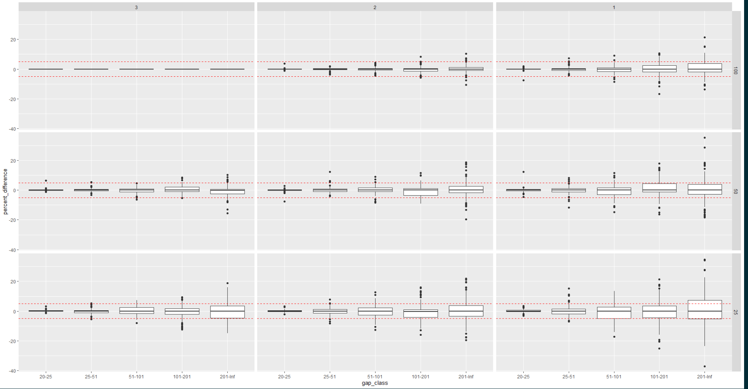
Difference from NWERN base

Slide 17
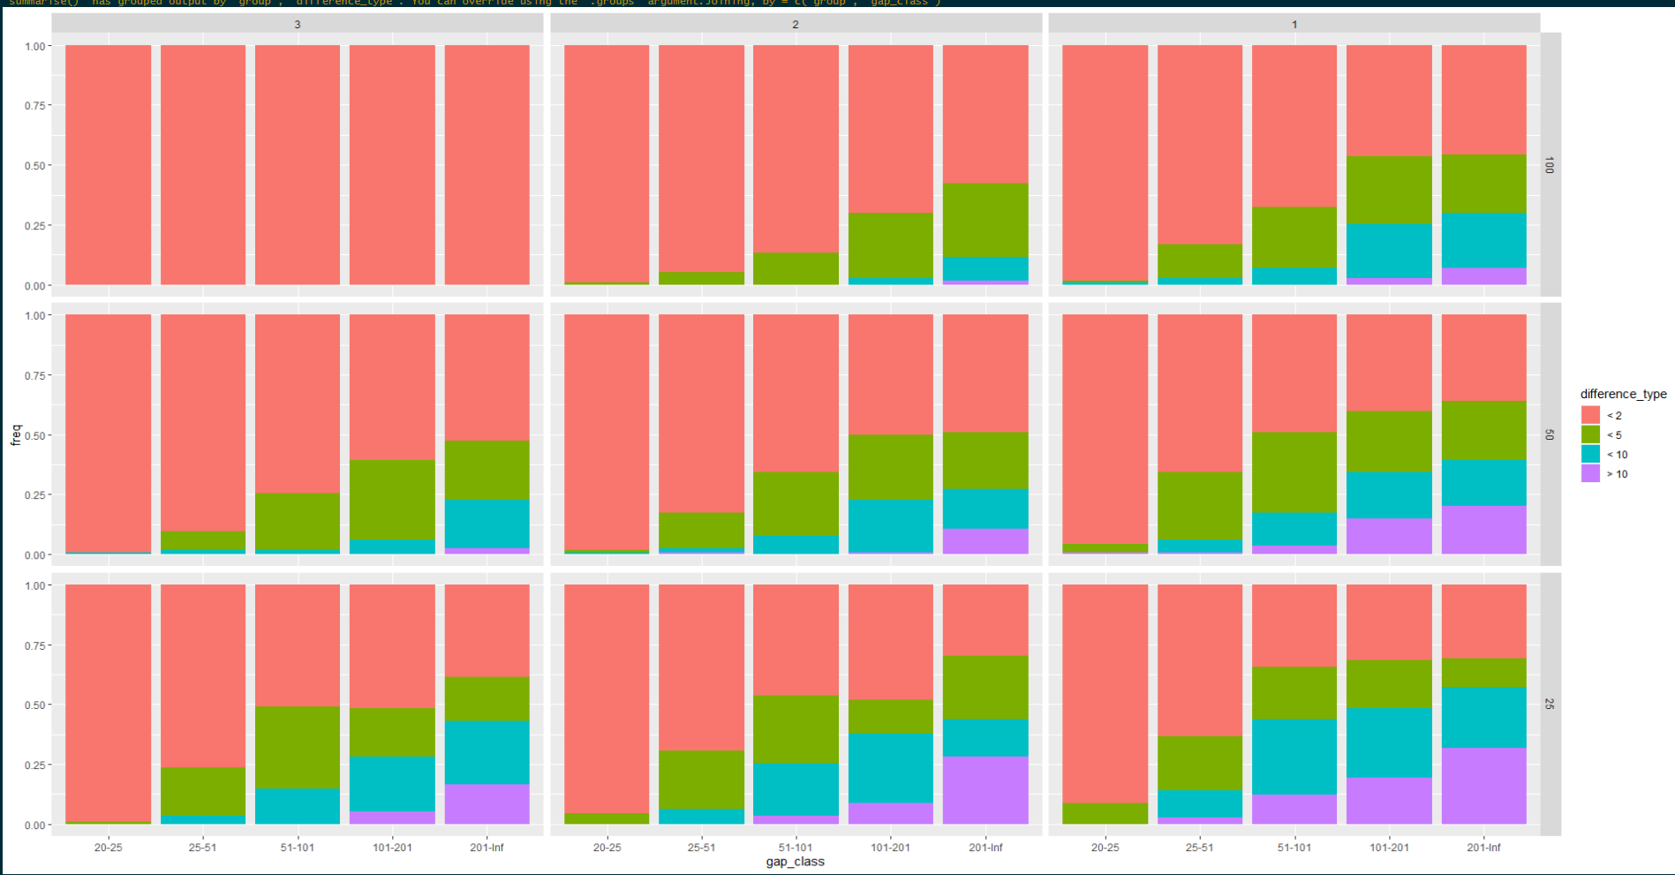
Proportion of difference from NWERN Base

Slide 18
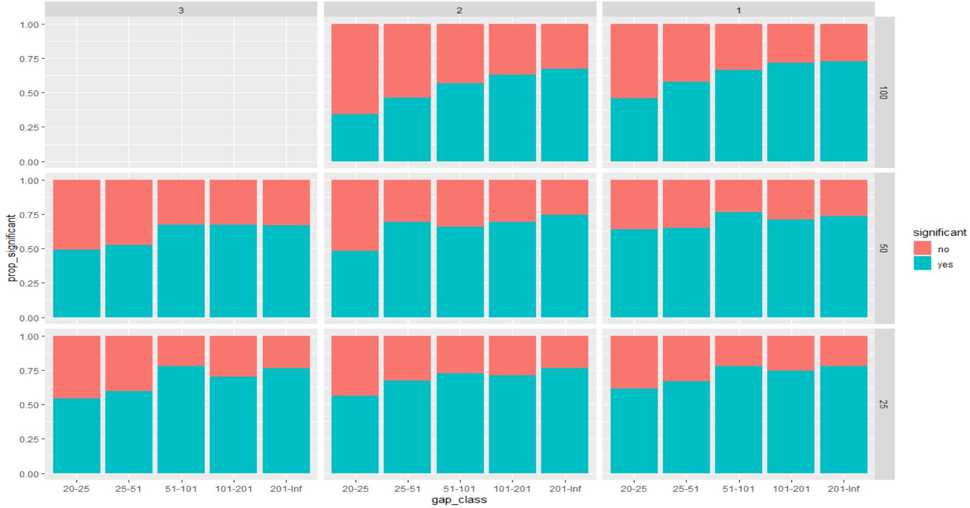
Proportion significantly different from base nwern

Slide 19
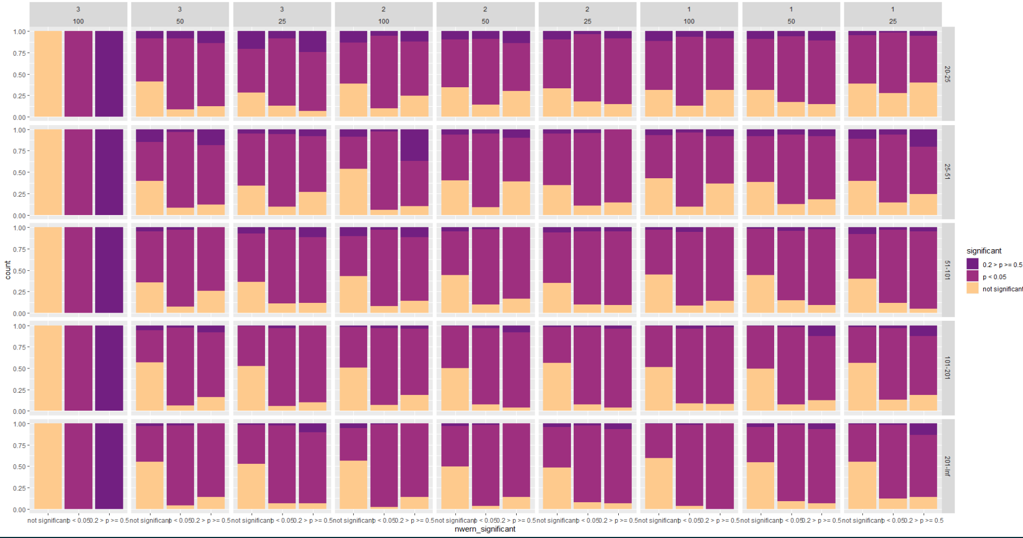
Proportion - Plot visit significant differences –both p < 0.05 and p < 0.2

Slide 20
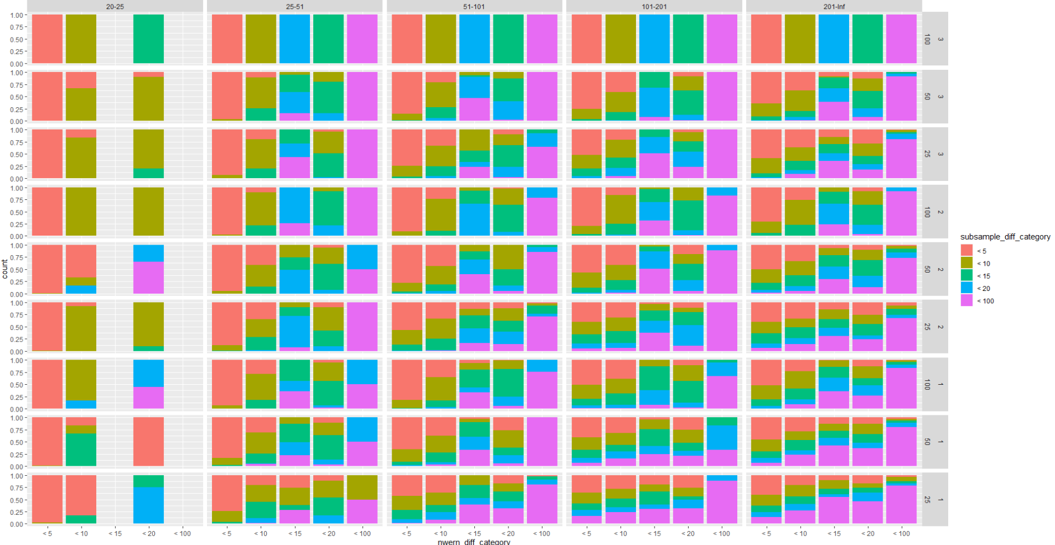
Plot visit absolute differences

